Slide 1
Concurrency Control : Mutual Exclusion, Locks
Dr Muhammad Saeed

Slide 2
Outlines
Concurrency & Race Condition (recap)
Producer Consumer Problem
Mutual exclusion
Synchronization
Semaphore
Counting and binary
Mutual Exclusion
Mutex
Race Condition – solution
Lock based Concurrent Data Structures

Slide 3
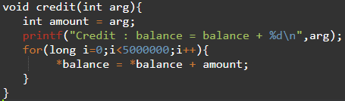
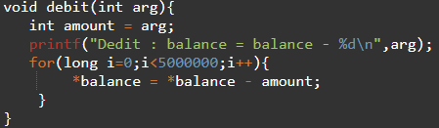
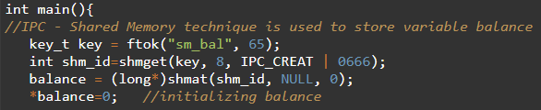
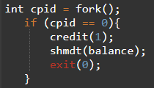
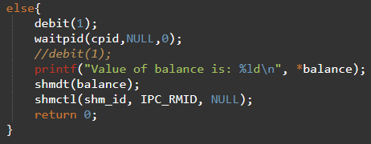

Concurrency & Race Condition

Slide 4
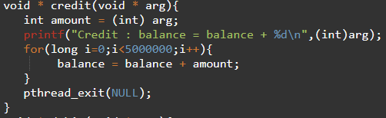
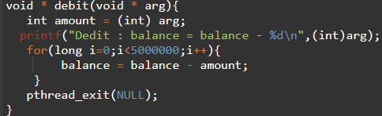
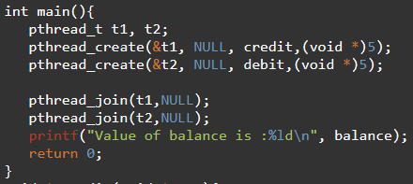

Concurrency & Race Condition

Slide 5
Larger Context
Client/Server Applications
Peer to Peer Applications
Producer / Consumer Problem
Readers / Writers Problem

Slide 6
Produce/ Consumer Problem
N = 0,1,2 . . . . .
P0
P1
C
P2
Pn

Slide 7
Solution
Requirements
Mutual Exclusion
Synchronization
Semaphore
Programming Techniques
Mutex & Condition Variables
Semaphore

Slide 8
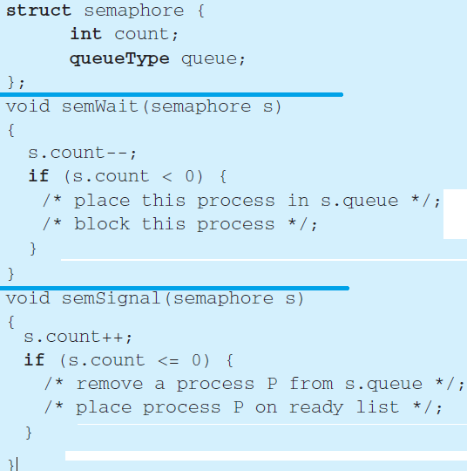
Semaphore (counting)

Slide 9
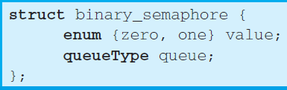
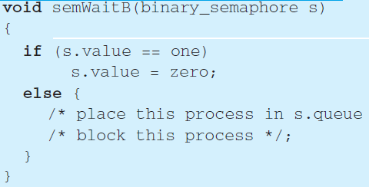
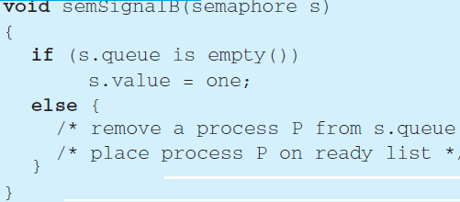
Semaphore (binary)

Slide 10
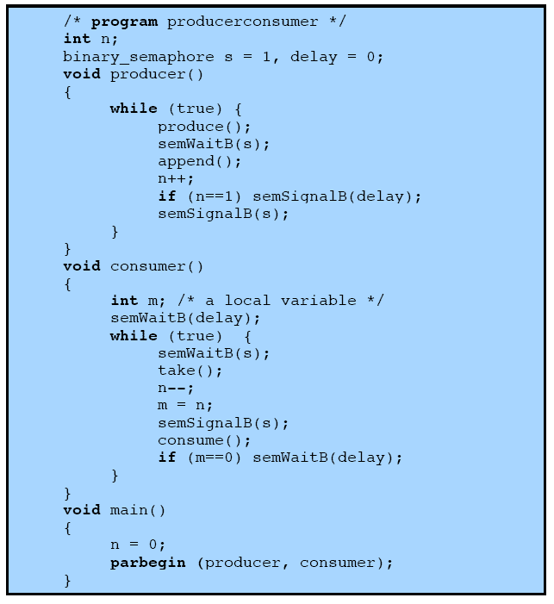
Producer / Consumer - Solution
Notes:
A fix for the problem is to introduce an auxiliary variable that can be set in the consumer’s critical section for use later on.

Slide 11
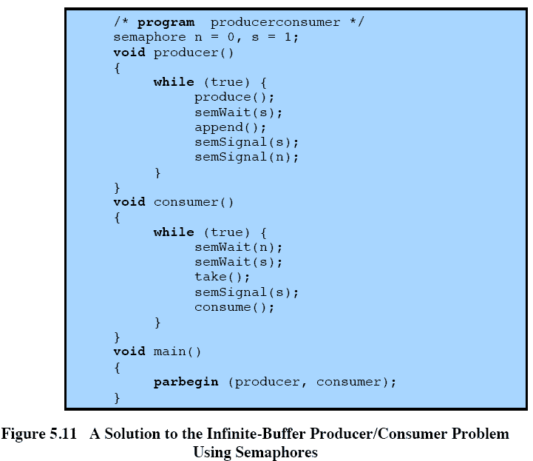
Producer / Consumer - Solution
Notes:
A fix for the problem is to introduce an auxiliary variable that can be set in the consumer’s critical section for use later on.

Slide 12
Mutual Exclusion
To protect shared resources from race condition and data inconsistency. (Balance = Balance +/- Amount)
Thread 1 | Thread 2 | Shared Data X
A = X |  | 100
 | B = X | 100
 | B = B + 300 | 100
A = A + 200 |  | 100
X = A |  | 300
 | X = B | 400

Slide 13
Thread - Issues
When we have a number of threads accessing a shared resource
Multiple threads can enter critical section simultaneously
Critical section may be interrupted in the middle
How can we make the critical section mutually exclusive!
i.e. only one thread can enter a critical section at any given instant
This would have the effect of the critical section being atomic!
Solution
Locks

Slide 14
Mutex
Library - #include <pthread.h>
Structure
pthread_mutex_t
Fuctions
pthread_mutex_init (mutex , attr)
pthread_mutex_destroy (mutex)
pthread_mutexattr_init (attr)
pthread_mutexattr_destroy (attr)

Slide 15
Locking and Unlocking Mutex
Functions
pthread_mutex_lock (mutex)
pthread_mutex_unlock (mutex)
pthread_mutex_trylock (mutex)

Slide 16

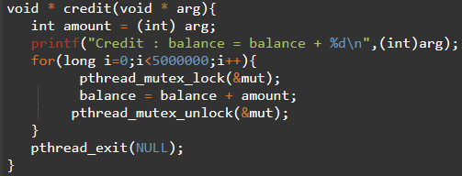
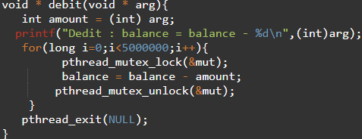
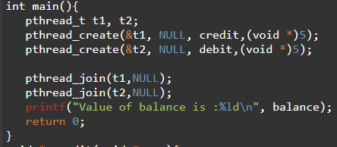

Race Condition - Solution

Slide 17
Reading Assignment
Types of locks and locking strategies
Their pros and cons
Two phase and Three phase locking

Slide 18
Locks
Locks are constructs provided by the OS (or libraries)
Locks can be acquired and released
With OS (and hardware) support, it is ensured that only one thread can acquire a given lock at any given time!
We use locks to protect our critical sections in multiple threads

Slide 19
Locks (2)
A lock is a variable which can be in any of two states:
Available (or free, or unlocked)
Acquired (or held, or locked)
When a thread calls lock() on a particular lock variable
if the lock is in free state, it acquires the lock, and lock() function returns
If the lock is in held state, it will block and the lock() function will not return until it has acquired the lock
A thread can free an acquired lock by calling unlock() on it.

Slide 20
Lock (3)
Two approaches to locking
Coarse-grained locking: Having one big lock used when any critical section is accessed
Fine-grained locking: Having different data and data structures with different locks
Pthread locks (mutexes)

Slide 21
Evaluating Locks
Goals:
Correctness - Achieve mutual exclusion
Fairness – Give chance to each waiting thread
Performance - Be efficient
Single thread single processor
Multiple threads single processor
Multiple threads multiple processors

Slide 22
Lock Implementation-Disable Interrupt
First solution
Disable interrupts
CPU has special instructions for this
Works for single processor systems
Issues
Turning off interrupts is a privileged operation
If interrupts are off, useful interrupts can be lost

Slide 23
Lock Implementation – Use Flag
Second solution
Use a variable (flag) to communicate b/w threads

Slide 24
Lock Implementation – Use Flag
Second Solution
Issues
Performance (spin waiting)
Correctness? No Mutual Exclusion

Slide 25
Lock Implementation - (Use H/W Support)
Accessing a shared flag might be interrupted hence mutual exclusion may not be possible
Third solution – Use hardware support
test-and-set (atomic exchange) instruction
It provide an atomic instruction

Slide 26
Lock Implementation - (Use H/W Support)
Test-and-set spin lock
Issues
Needs a preemptive scheduler on a single processor otherwise a thread may never relinquish the CPU

Slide 27
Evaluating spin locks
Correctness
Yes it provides mutual exclusion
Fairness
No, spin locks don’t provide fairness guarantee (a thread spinning may lock the CPU causing waiting threads to starve
Performance
Worse performance if the thread holding the lock is preempted within a critical section
All other threads will wait spin wasting CPU cycles

Slide 28
Lock Implementation – (Use H/W Support)
compare-and-swap instruction

Slide 29
Lock Implementation – (Use H/W Support)
load-linked and store-conditional instruction
Both instructions operate in tandem

Slide 30
Lock Implementation – (Use H/W Support)
Store-conditional succeeds only if no intervening store has happened to that address since the last load-linked!!

Slide 31
Lock Implementation – (Use H/W Support)
fetch-and-add instruction
Used to implement ticket lock

Slide 32
Lock Implementation – (Use H/W Support)
All lock implementations using hardware support spin wait wasting CPU cycles
We can avoid spin wait by process calling yield function to voluntarily give the CPU time to other waiting thread
Requires support of the operating system, yield is a system call

Slide 33
Lock Implementation – Using yield

Slide 34
Locks Implementation – Use Queues
Use Queues
Notes:
Queues give us more control on which thread to schedule next.

Slide 35
Sleep instead of spinning, if lock is held.
Park() and unpark() support provided by Solaris for sleep
guard is a spin lock around flag and wait queues
some spinning is done but only for the time we access the flag & queue
Flag is not set to 0 on unpark()!
Notes:
Race condition just before call to park()! T1 wants to call park() but gets interrupted. T0 frees the lock, since no thread in queue, it doesn’t wake any one. T1 gets rescheduled, calls park. Now there’s nobody to wake it up!!

Slide 36
Futexes
Notes:
https://news.ycombinator.com/item?id=17524169

Slide 37
Futexes
MSB is the status
All other bits keep count

Slide 38
Two-phased locks
If the lock his held, spin for a while to see if it’s acquirable in near future.
If not, then go to sleep.

Slide 39
Summary
We saw what are the different mechanisms of locks and how are they implemented
We saw the role that hardware support provides in lock implementation
We saw the different metrics on which a lock implementation is evaluated (correctness, fairness and performance)
We also saw how spin locks waste CPU cycles and so alternate OS supported functions like yield and sleep are used to improved performance

